Slide 1
Spark Machine Learning (MLlib)

Slide 2

Learning Objectives
Understand the fundamentals of Spark MLlib library and its algorithms
Prepare and preprocess data for machine learning tasks using Spark
Implement and tune various machine learning algorithms using Spark MLlib
Evaluate model performance and interpret results
Spark Machine Learning (MLlib)

Slide 3
Machine Learning Exploration

Slide 4


What is Spark MLlib?
Machine learning is an AI discipline that uses algorithms to learn from data, identify patterns, and make decisions or predictions with minimal human intervention, enhancing through experience and large data processing.
Apache Spark MLlib is a distributed machine learning library that is part of the Apache Spark ecosystem.
Spark MLlib Overview

Slide 5
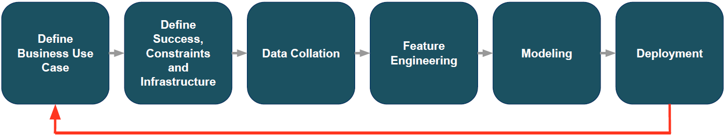
Machine Learning Workflow
Spark MLlib Overview

Slide 6
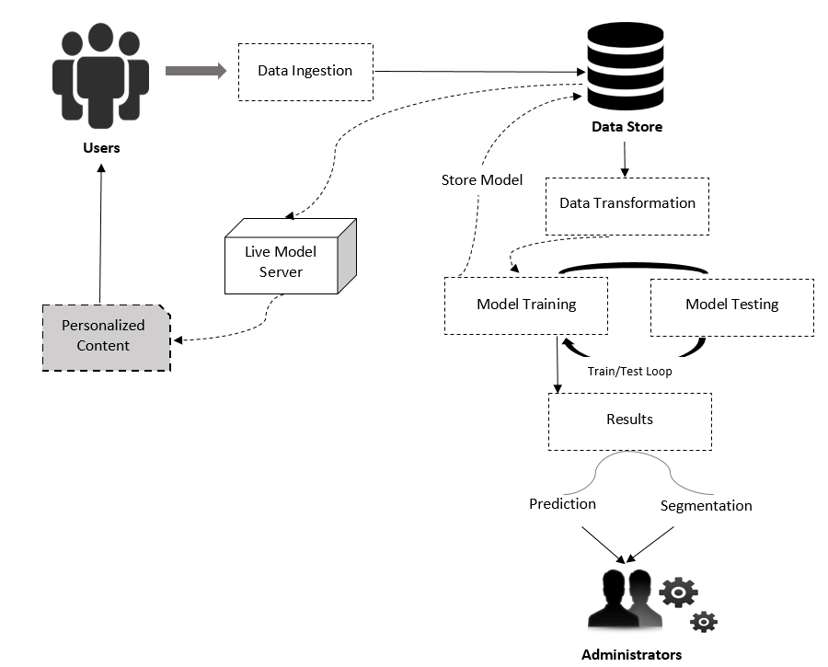
Machine Learning Architecture
Spark MLlib Overview

Slide 7
Spark MLlib Key Points
Designed for simplicity, scalability, and easy integration.
Comprises common learning algorithms and utilities (classification, regression, clustering, collaborative filtering, etc.)
Can be used in Java, Python, scala and R
Enables Big Data preprocessing, munging, model training, and prediction at scale on large datasets.
Leverages Spark's distributed computing capabilities
Integrates seamlessly with other Spark components like Spark SQL, Spark Streaming, etc.
Provides high-quality algorithms and can run on various cluster managers.
Spark MLlib Overview

Slide 8
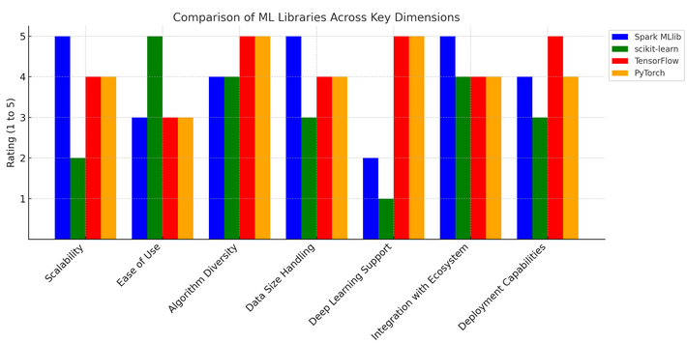
Spark MLlib VS Other ML Tools
Spark MLlib Overview

Slide 9
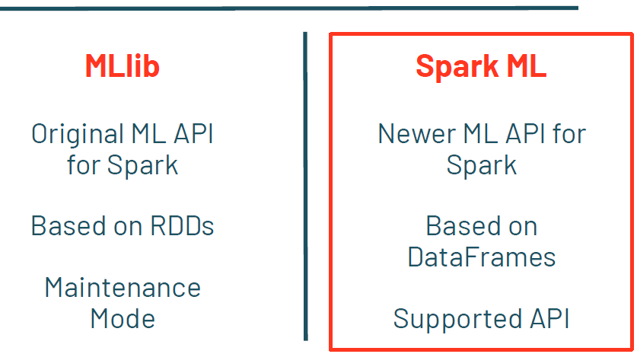
Spark.mllib VS spark.ml
Spark MLlib Overview

Slide 10
MLlib Basic Data Types
MLlib in Apache Spark, supports several data types that are essential for machine learning tasks. Among them, we have:
Local Data Types:
1. Local Vector: A local vector can be either dense or sparse.
Dense Vector: Backed by a double array representing its entry values. For example, a dense vector (1.0, 0.0, 3.0) is represented as [1.0, 0.0, 3.0].
Sparse Vector: Backed by two parallel arrays: indices and values. For example, a sparse vector (1.0, 0.0, 3.0) can be represented as (3, [0, 2], [1.0, 3.0]), where 3 is the size of the vector.
Spark MLlib Overview

Slide 11
MLlib Basic Data Types
Local Data Types:
2. Local Matrix: Similar to local vectors, local matrices can be dense or sparse. They are used for linear algebra operations
Labeled Point:
A labeled point is a local vector (dense or sparse) associated with a label/response. It is used in supervised learning algorithms. For binary classification, labels are 0 (negative) or 1 (positive). For multiclass classification, labels are class indices starting from zero.
Spark MLlib Overview

Slide 12
MLlib Basic Data Types
Distributed Data Types:
These data types are backed by one or more Resilient Distributed Datasets (RDDs) and are used for large-scale operations across a cluster.
RowMatrix: Represents a distributed matrix where each row is an instance of a local vector.
IndexedRowMatrix: Similar to RowMatrix but includes row indices.
CoordinateMatrix: Represents a distributed matrix using coordinate format (row index, column index, value).
BlockMatrix: Represents a distributed matrix in block format, useful for distributed matrix operations.
Spark MLlib Overview

Slide 13
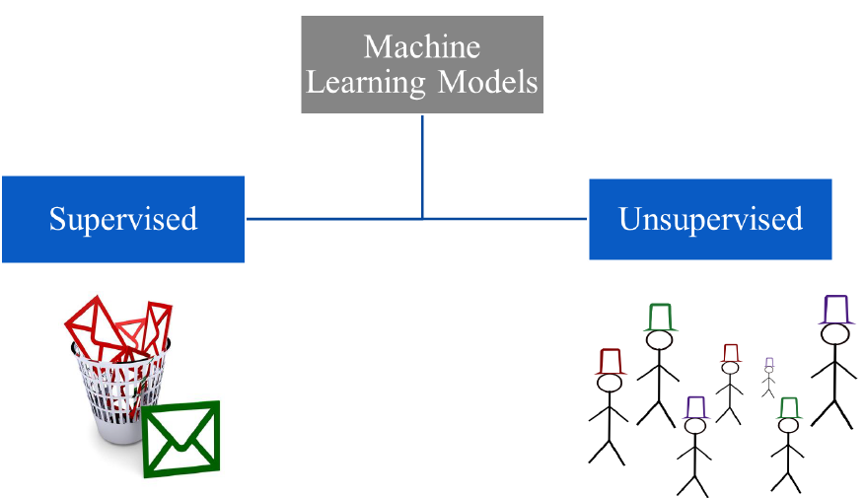
Types Of Machine Learning
Spark MLlib Overview

Slide 14
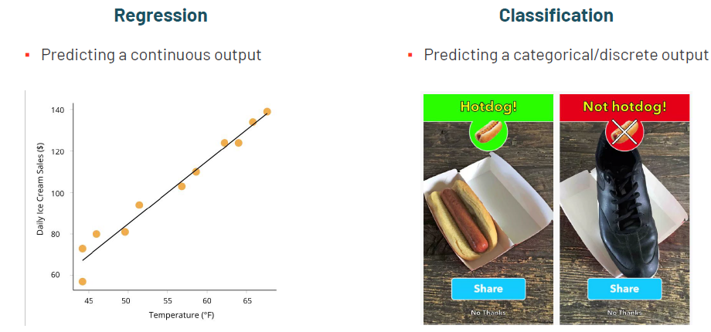
Types Of Machine Learning
Supervised Learning Models
Supervised learning algorithms, categorised into classification and regression, are utilised when training data includes both input features and desired output labels.
Spark MLlib Overview

Slide 15
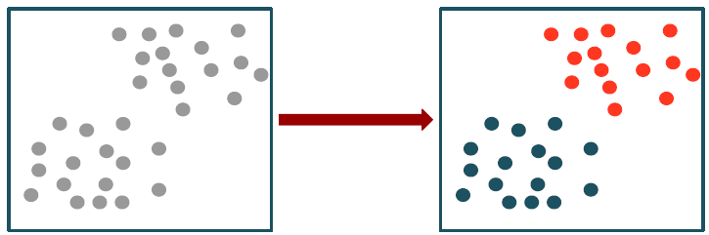
Types Of Machine Learning
2. Unsupervised Learning Models
Unsupervised learning algorithms are used when the training data only includes input features without any labels. These algorithms are used to find patterns or groupings in the data.
Spark MLlib Overview

Slide 16
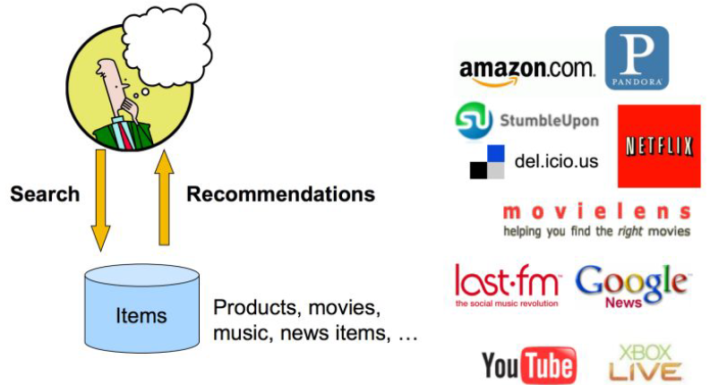
Types Of Machine Learning
3. Collaborative Filtering
Collaborative filtering is used in recommendation systems to predict user preferences based on past interactions.
Spark MLlib Overview

Slide 17
Prepare Data For Machine Learning

Slide 18
Useful Public Dataset Sources
UCI Machine Learning Repository: http://archive.ics.uci.edu/ml/
Amazon AWS public datasets: http://aws.amazon. com/publicdatasets/
Kaggle: http://www.kaggle.com/competions
KDnuggets: http://www.kdnuggets.com/ datasets/index.html
Data Preprocessing

Slide 19
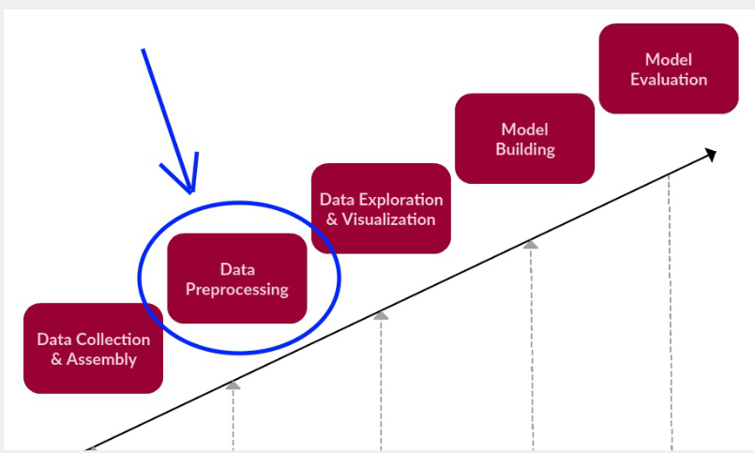
What is Data Preparation ?
Pre-processing is the process of doing a pre-analysis of data, in order to transform them into a standard and normalised format.
Pre-processing usually involves these aspects: missing values, data standardisation, data normalisation, data binning etc.
Data Preprocessing

Slide 20
Why Preparing Data?
Improving Data Quality
Enhancing Model Performance
Reducing Model Complexity
Handling Categorical Data
Ensuring Consistency
Improving Generalization
Reducing Overfitting
Data Preprocessing

Slide 21
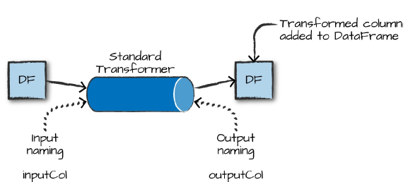
MLlib Key Components
Transformers:
A transformer is an abstraction that includes feature transformers and learned models. It implements a transform() method, converting one DataFrame into another by appending columns.
Data Preprocessing

Slide 22
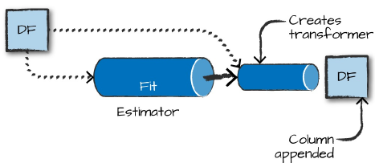
MLlib Key Components
2. Estimators:
An Estimator is a learning algorithm that fits or trains on data, implementing a method called fit() that accepts a DataFrame and produces a Model, which is a Transformer. For instance, a LogisticRegression algorithm is an Estimator, which trains a LogisticRegressionModel.
Data Preprocessing

Slide 23
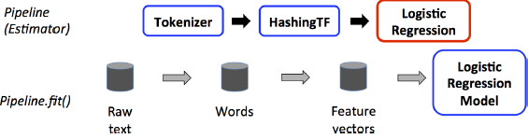
MLlib Key Components
3. Pipeline:
A pipeline is a sequence of stages, each a Transformer or an Estimator, which are run in order and transform the input DataFrame.
Transformer stages use the transform() method on the DataFrame,
while Estimator stages use the fit() method to produce a Transformer, which becomes part of the PipelineModel.
Data Preprocessing

Slide 24
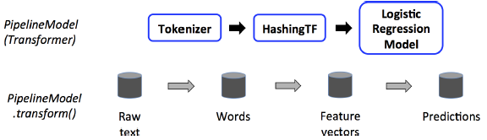
MLlib Key Components
3. Pipeline:
A Pipeline Model is the result of fitting a Pipeline. It retains the entire workflow, meaning it stores the Transformers and Estimators that were fitted to the data.
Pipelines and Pipeline Models help to ensure that training and test data go through identical feature processing steps.
Data Preprocessing

Slide 25
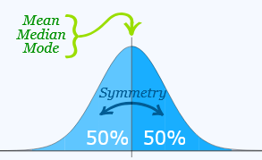
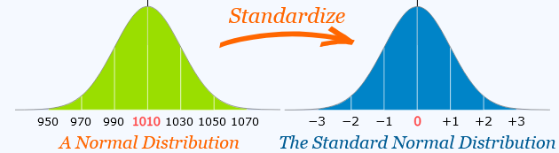
Standardisation
Standardisation is a process where data is mapped to a bell-shaped curve or normally distributed, resulting in a variance of 1 and/or a mean value of 0. This is done to improve the performance of machine learning algorithms like SVM, resulting in a slightly shifted data shape.
Data Preprocessing

Slide 26

Standardisation
The formula to convert values in a non-standardized column to a standardized form is given by:
Importance:
Ensures all features contribute equally to the model
Improves numerical stability
Can lead to faster convergence in optimization algorithms
Data Preprocessing

Slide 27
Standardisation
Example Scenario:
Imagine you are working on a dataset to predict house prices. The dataset includes features like the number of bedrooms, square footage, and the age of the house. These features have different scales and units. Here, standardizing the data can help ensure that each feature contributes equally to the model, improving its performance.
In this example, StandardScaler will be used to standardise the features so they have a mean of zero and a standard deviation of one. This ensures the model training process is not biased by the scale of the features.
Data Preprocessing

Slide 28
Normalisation
Normalisation is the process of transforming numeric data from its original range to a range of 0 to 1. The lowest number in the original range receives a value of 0, while the highest receives a value of 1. All of the remaining numbers in the original range will fall between these two.
Data Preprocessing

Slide 29
Normalisation
Normalisation is necessary since there may be several attributes with disparate ranges.
For example, salary values might range from 3 to 8 digits, while years in the organisation can range from 1 to 2 digits. The reason we wish to normalise those attributes in a [0,1] range is so that algorithms that utilise distance as a metric do not overvalue specific attributes, such as salary.
Data Preprocessing

Slide 30
Normalisation
Importance of Normalisation in Machine Learning:
Ensures Consistent Scale: Normalisation ensures all features have a consistent scale, crucial for algorithms like K-means clustering and K-nearest neighbors.
Improves Convergence: Normalisation enhances convergence in gradient-based optimization algorithms like logistic regression or neural networks.
Data Preprocessing

Slide 31
Normalisation
Importance of Normalisation in Machine Learning:
Handles Different Units: Normalisation brings features with different units to a comparable scale, aiding effective learning.
Avoids Bias: Without normalisation, larger values could dominate the model, leading to biased results.
Improves Performance: Normalised input data improves model performance by learning underlying patterns more effectively.
Data Preprocessing

Slide 32

Normalisation
Spark MLlib contains a series of transformers that allow to normalise data.
MinMaxScaler():
transforms a dataset of Vector rows, rescaling each feature to a specific range (often [0, 1]). It takes parameters:
The formula to convert values in an un-normalized column to a normalized form is given by:
Data Preprocessing

Slide 33
Normalisation
2. MaxAbsScaler ():
MaxAbsScaler computes the maximum absolute value for each feature and then divides each value by this maximum absolute value. This ensures that the scaled feature values fall within the range [−1, 1]. Its parameters are:
inputCol: The name of the input column containing the feature vectors that need to be scaled.
outputCol: The name of the output column where the scaled feature vectors will be stored.
Data Preprocessing

Slide 34
Normalisation
3. Normalizer():
The Normalizer transformer rescales each feature vector to have a unit norm. This is done by dividing each element of the feature vector by the vector's norm.
This is particularly useful for text classification and other scenarios where the magnitude of the feature vectors should be consistent. It scales each feature vector to have a Euclidean norm (L2 norm) of 1.
Data Preprocessing

Slide 35
Normalisation
3. Normalizer():
Parameters of Normalizer:
inputCol: The name of the input column containing the feature vectors that need to be normalized.
outputCol: The name of the output column where the normalized feature vectors will be stored.
p: The p-norm to use for normalization. Default is 2.0, which corresponds to the L2 norm.
Data Preprocessing

Slide 36
LET’S GO THROUGH THE NOTEBOOK!!!!
Programme Handbook

Slide 37
ML Model Evaluation & Tuning

Slide 38
Objectives
Most of the time when we build Machine Learning models, it is very important to determine whether the model is accurate or performant. Spark MLlib offers a wide range of metrics to evaluate our models, allowing us to choose what models best fit our business case in terms of objectives.
In this part of the content, we are going to explore common metrics being used to evaluate regression and classification models. Also, we are going to explore few techniques to tune our models in other to facilitate the deployment.

Slide 39
Model Evaluation Metrics

Slide 40
What is Model evaluation?
A machine learning (ML) model is an algorithm that has been trained on a dataset to execute a specific prediction job. Model assessment seeks to determine how effectively a model fulfils its task.
The model's performance can change both between and within use cases, for example, by selecting various algorithm or data selection parameters. As a result, we must verify the model's correctness after each training run. Typically, many models are tested with and produced for the same use case. This means that we must compare the performance of several models during evaluation.
Overview

Slide 41
Why Do We Evaluate Models?
A model evaluation in machine learning:
Identifies the Best-Performing Models: Model evaluation helps identify the best model for a given problem by defining evaluation metrics. It helps assess a model's performance and understand its strengths and weaknesses.
Increases Accuracy: Classification accuracy measures the model's accuracy by dividing the number of correct predictions by the total number of predictions made. It helps in comparing different models and identifying areas for improvement.
Overview

Slide 42
Why Do We Evaluate Models?
Prevents Overfitting: Overfitting is a significant cause of poor model performance, where a model memorises the training data instead of generalising it to new or unseen data. Model evaluation helps detect and prevent overfitting early on.
Helps Achieve Organisational Goals: Model evaluation helps organisations achieve business goals by ensuring the model is useful, accurate, and reliable when deployed in the real world.
Prevents Risks: Model evaluation in sensitive industries like healthcare can help identify areas for improvement, saving lives and preventing dangers.
Overview

Slide 43
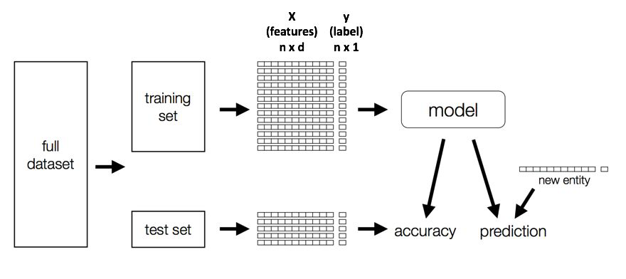
Build An Evaluation Model ?
Overview

Slide 44
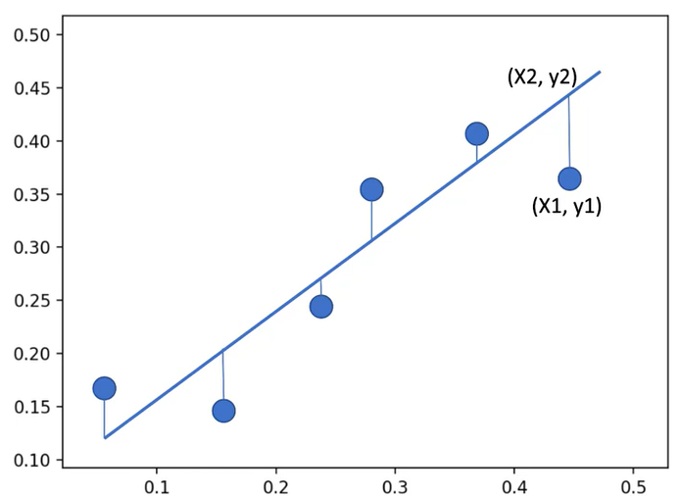
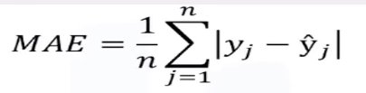
Mean Absolute Error (MAE)
L1 loss measures the average absolute difference between the actual values and the predicted values, by giving equal weight to all errors, regardless of their magnitude. It’s represented using the formula:
Regression Metrics

Slide 45
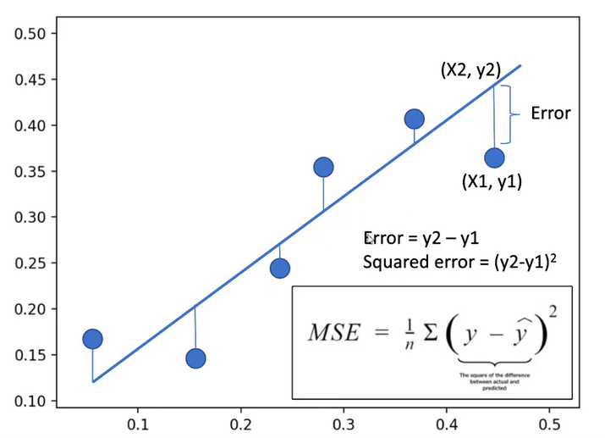

Mean Squared Error (MSE)
MSE (L2 loss) measures the average difference between actual and predicted values, penalising larger errors more heavily than smaller ones, making it sensitive to outliers. A very good metric to evaluate a model, it’s formula is:
Regression Metrics

Slide 46
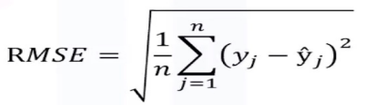
Root Mean Squared Error (RMSE)
RMSE is the square root of the MSE. It provides a measure of the average magnitude of errors in the same units as the target variable. It tells you how concentrated the data is around the line of best fit, and its formula is:
Regression Metrics

Slide 47
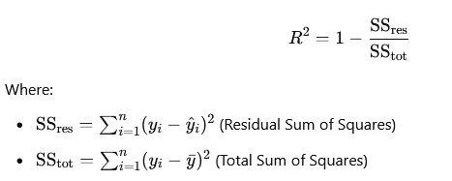
R² Score
Also known as the coefficient of determination, it measures the proportion of variance in a target variable explained by a model. It ranges from 0 to 1, with 1 indicating perfect prediction. R² is used to assess model goodness-of-fit.
Regression Metrics

Slide 48
Overview
Classification algorithms and models evaluations (Binary, Multiclass/Multilabel classifications) share similar principles. Supervised classification problems have true output and model-generated predicted output for each data point, allowing results to be assigned to one of four categories.
True Positive (TP) - label is positive and prediction is also positive
True Negative (TN) - label is negative and prediction is also negative
False Positive (FP) - label is negative but prediction is positive
False Negative (FN) - label is positive but prediction is negative
Classification Metrics

Slide 49
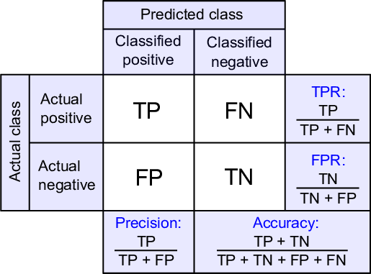
The Confusion Matrix
Classification Metrics

Slide 50

Accuracy
It represents the ratio of correct predictions (both positive and negative) out of the total predictions. It is best for balanced datasets with equal representation of classes, and can be misleading in imbalanced datasets, where 95% of samples belong to one class.
Classification Metrics

Slide 51

Precision
It is the ratio of correctly predicted positive observations to the total predicted positives. It Indicates how reliable positive predictions are.
Classification Metrics

Slide 52

Recall
The proportion of actual positive instances correctly predicted by the model. It measures how well the model identifies true positives.
Classification Metrics

Slide 53

F1 Score
Represents the harmonic mean of precision and recall, providing a balance between the two. High F1 Score indicates a good balance of precision and recall.
Classification Metrics

Slide 54

Specificity
Also referred to as the “True Negative Rate”, it represents the proportion of actual negative instances correctly predicted by the model. It complements recall by showing how well the model avoids false positives.
Classification Metrics

Slide 55
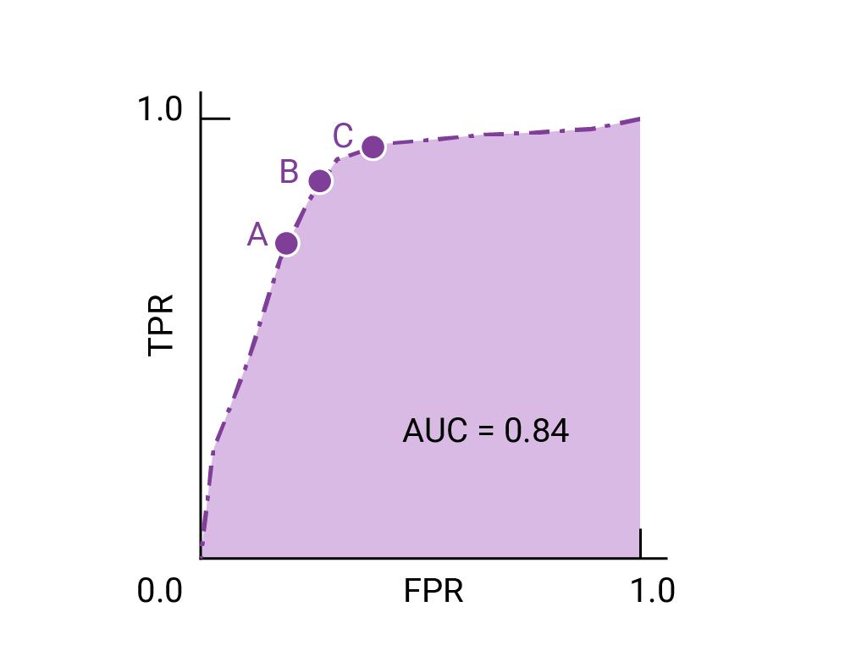
AUC-ROC
The Area Under the ROC Curve measures the ability of the model to distinguish between classes. The ROC Curve (Receiver Operating Characteristic Curve)plots the True Positive Rate (Recall) against the False Positive Rate.
Classification Metrics

Slide 56
ML Model Tuning

Slide 57
What Is Model Tuning?
Model selection, also known as tuning, is a crucial task in machine learning (ML) that involves using data to find the best model or parameters for a given task. Tuning can be done for individual estimators (such as LogisticRegression) or entire pipelines, allowing users to tune them all at once.
It helps in finding the optimal values of hyperparameters to maximize model performance.
Overview

Slide 58
How It Works In MLlib?
CrossValidator and TrainValidationSplit: Use Estimator, ParamMaps, and Evaluator to measure model performance.
Split input data into training and test datasets.
Fit Estimator with parameters.
Get fitted model.
Evaluate model performance.
Select best-performing model for model selection.
Overview

Slide 59
What Is Cross-Validation ?
Cross-validation is a rigorous statistical approach for evaluating the performance of a machine learning model. It is an important strategy for ensuring that the model generalises properly to new data, preventing overfitting and underfitting.
It involves partitioning the dataset into multiple subsets and training and validating the model multiple times to get a more reliable estimate of its performance.
Cross-Validation

Slide 60
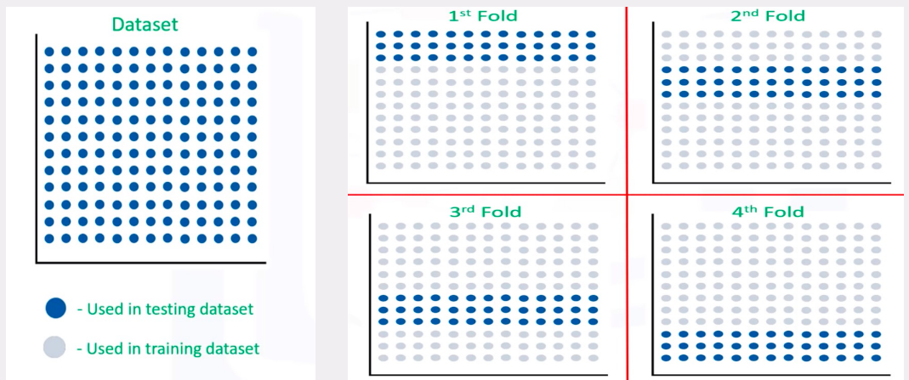
What Is Cross-Validation ?
Cross-Validation

Slide 61
Key Concepts in MLlib
Estimator: The algorithm or model you are training.
Evaluator: The metric used to evaluate the performance of the model, such as accuracy or AUC.
ParamGrid: A set of hyperparameters to be tuned during the cross-validation process.
CrossValidator: The MLlib component that performs cross-validation using the specified estimator, evaluator, and parameter grid.
Cross-Validation

Slide 62

What is Train-Validation Split?
The train-validation split is a crucial technique for evaluating machine learning model performance by dividing the dataset into a training and validation set, aiding in assessing model generalisation to unseen data and aiding in model tuning and selection.
Train-Validation Split

Slide 63
Key Points
Training Set: A subset of the dataset used to train the model. The model learns the underlying patterns and relationships in this data.
Validation Set: A subset of the dataset used to evaluate the model's performance during training. It helps in tuning hyperparameters and selecting the best model configuration without overfitting to the training data.
Train-Validation Split

Slide 64
Train-Validation Split Process
Data split into two parts: larger portion for training and smaller portion for validation.
Model trained using various algorithms and configurations.
Model performance evaluated using metrics like accuracy, precision, recall, F1 score, or RMSE.
Hyperparameter tuning based on validation performance.
Iterative process with multiple rounds of training, evaluation, and tuning for optimal model performance.
Train-Validation Split

Slide 65
LET’S GO TO THE DEMONSTRATION!!!
END

